Slide 1
Automatic fuzz testing and tuning tools for software blueprints
Ciprian Paduraru, Rares Cristea and Alin Stefanescu
University of Bucharest &
Institute for Logic and Data Science
Romania

Slide 2
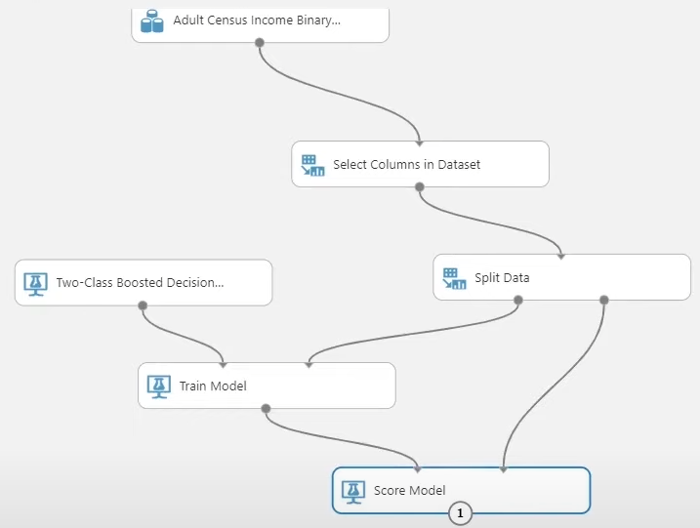
1. Intro and Motivation
Low-code or no-code application development – develop applications by connecting blocks and data flows.
Proven advantages of low-code / no-code paradigm:
A graphical way of structuring applications and architecture
Faster development through prototyping and reusability
More stakeholders with non-programming skills can participate in development phases
All results also in a better maintainability
Solid examples from industry:
Microsoft: Azure Services
https://powerapps.microsoft.com/en-us/low-code-no-code-development-platforms
IBM Cloud:
https://www.ibm.com/cloud/blog/low-code-vs-no-code
Google Cloud Services:
Credits: Microsoft Azure Machine Learning Studio training
https://cloud.google.com

Slide 3
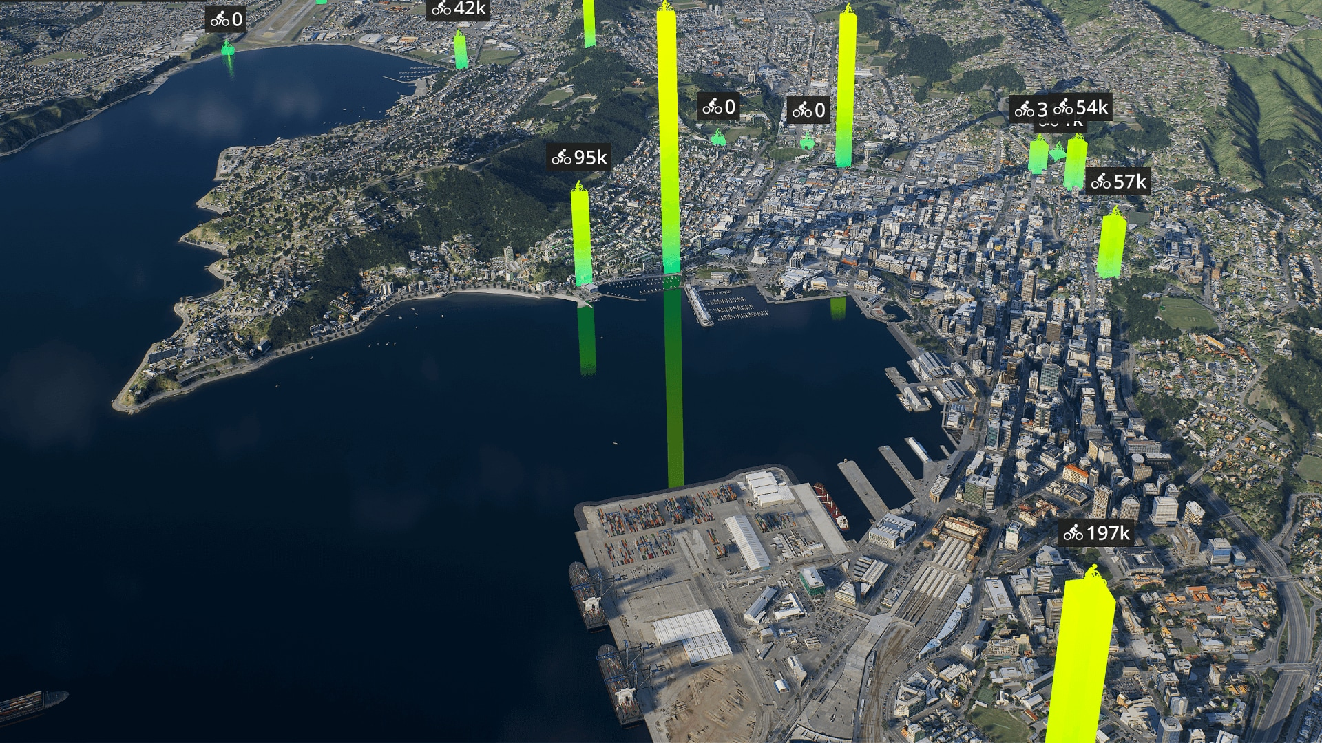
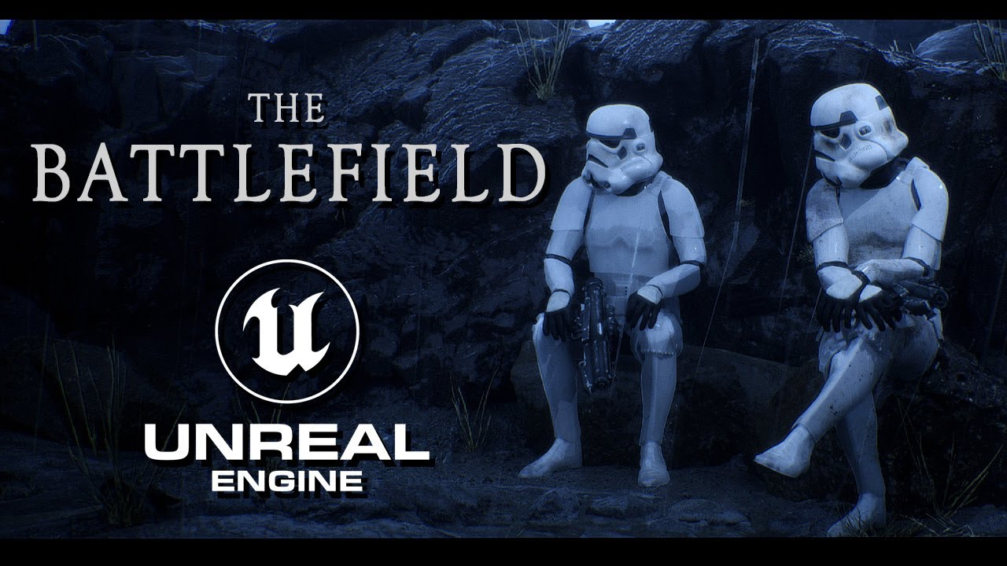

After research we concluded that there is currently a large gap in automated end-to-end testing no/low code applications.
Based on expertise we focus on simulation and games applications, although the techniques can adapt to several other use-cases !
We use a common open-source development engine, Unreal Engine 5 https://docs.unrealengine.com
(gaming, film-making, digital twins, etc.).
Our goal: develop automated testing methods for low-code or no-code methodologies

Slide 4
Contributions:
Proposing and implementing an open-source framework delivered as a plugin architecture to generate tests with less human effort
https://github.com/AGAPIA/EBLT
(including documentation, examples, demos)
Concrete requirements, common problems and solution validation made with our local industry collaborations along Ubisoft, Amber, EA.
We provide a formal abstraction of no-/low-code definitions
Support for tuning, i.e., automatize design of behaviors and environments.

Slide 5
2. Software blueprints
Objectives:
Provide the semantic capabilities in object-oriented programming in common programming languages, but in a graphical representation.
Allow various stakeholder to take part of the development process.
In game engines, blueprints are defined usually with a scripting tool
This allowed stakeholders with 0-programming expertise to write good games from scratch !

Slide 6
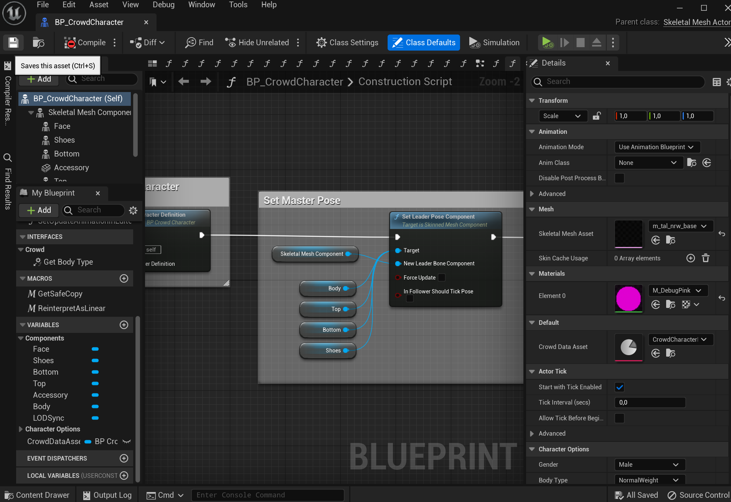


Anatomy and graphical look of a blueprint in Unreal Engine 5
Main idea: connect blocks of operations (defined in blueprints or source code) AND create data workflows
Showing the selected blueprint
Interface/virtual functions
Variables definition
Events, dispatchers
Blocks such as Set Leader Pose Component implement functionality defined in either:
A) Another blueprint
B) Source code, e.g., C++, C#, Python, etc.
Properties panel of a selected block
Internal functionalities definition and design.
Inputs are coming from the left side, outputs are going through right side

Slide 7
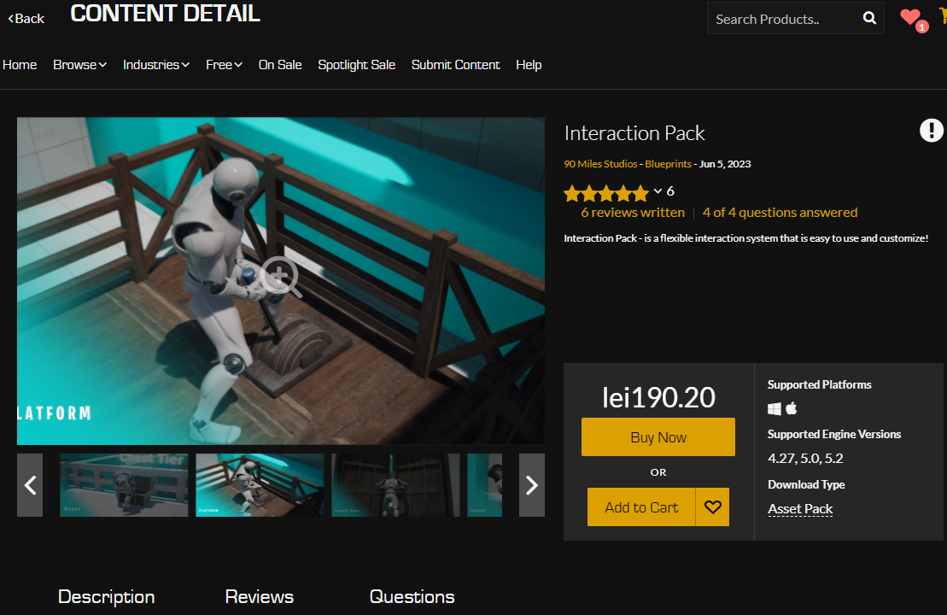
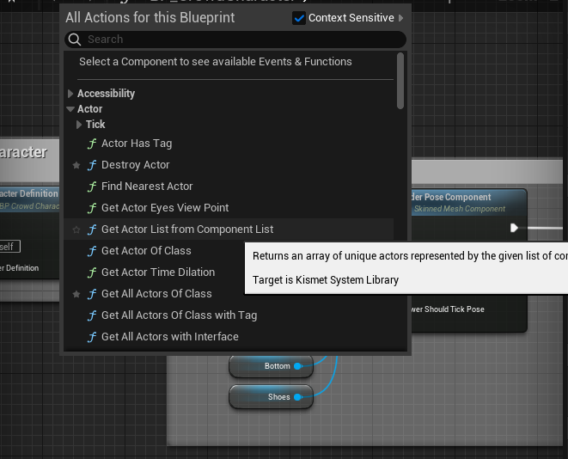
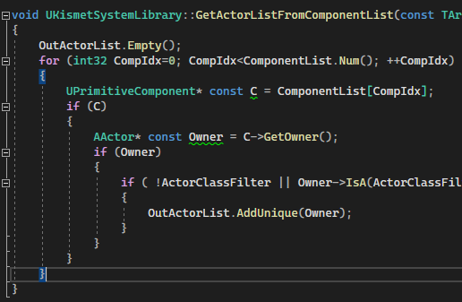
The building blocks can be added from the graphical interface, then connected with other pieces.
They can be defined either by stakeholders or from a set of publicly available library (e.g., EPIC Marketplace)
Reusability is one of the most important feature of blueprints !

Slide 8
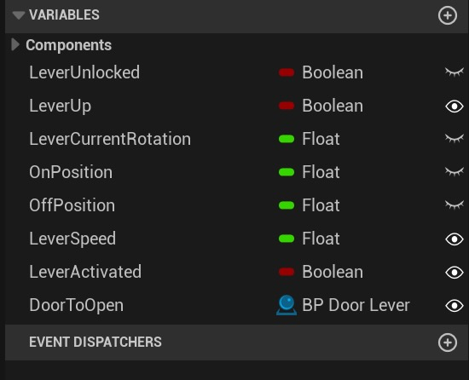
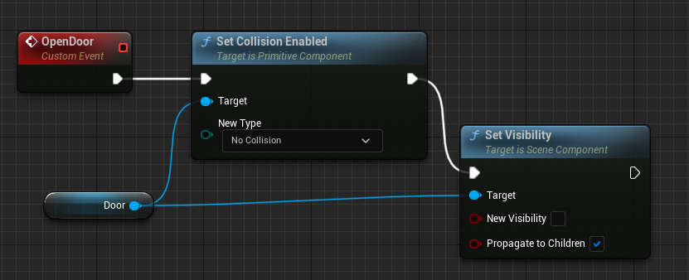

Blueprints vs OOP programming features :
Visibility to external blueprints.
Blueprints can contain variables (members) of any kind, either default types or user-defined data structures, references to other blueprints. Aggregation
Internal (possibly hidden) functionality and data , i.e., Encapsulation.
private
public

Slide 9

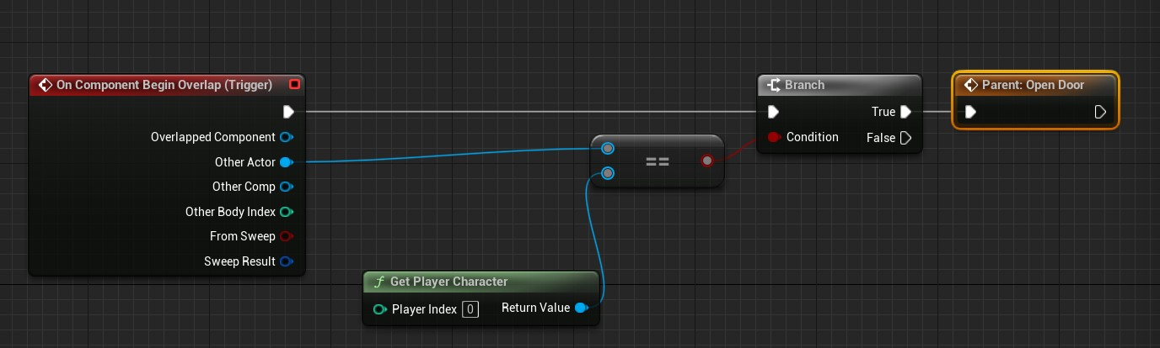
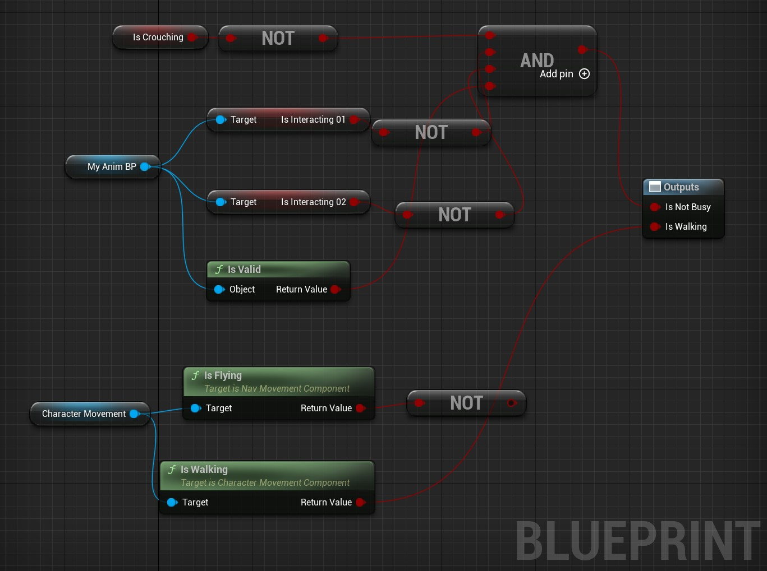
Blueprints vs OOP programming features :
Example of function calling inside a blueprint
Communication with other blueprints or components of the system is possible as follows:
Interfaces for function calls.
Event-based systems, i.e., like the observer pattern.
References between blueprints.
Example of listening to a collision overalling event, then doing local logic inside a blueprint. Finally, calling an event “Open Door” that could be listened in other blueprints or source code.
This show a communication where a blueprint retrieves data from two blueprint references, uses a local variable and some logic to write an output.
The output can then be used by external components or blueprints.

Slide 10
Blueprints vs OOP programming features :
Blueprints can be derived to create hierarchies as in OOP
Register functions to serve as constructors and destructors.
And they can define virtual functions.
Check the full paper and engine documentation for more details.

Slide 11
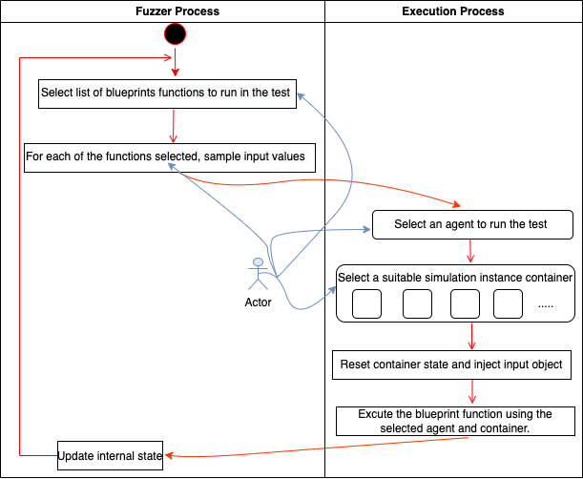
3. Methods
Proposed framework architecture - Overview
Fuzzer: selects the functions and inputs for execution. Guidance methods are also included here
Executor: selects the agent (external, independent, pluginable) to be used for execution and executes the simulation environment in one of the available clusters.
Note: feedback is also recorded to improve
Fuzzer’s guidance mechanisms.

Slide 12
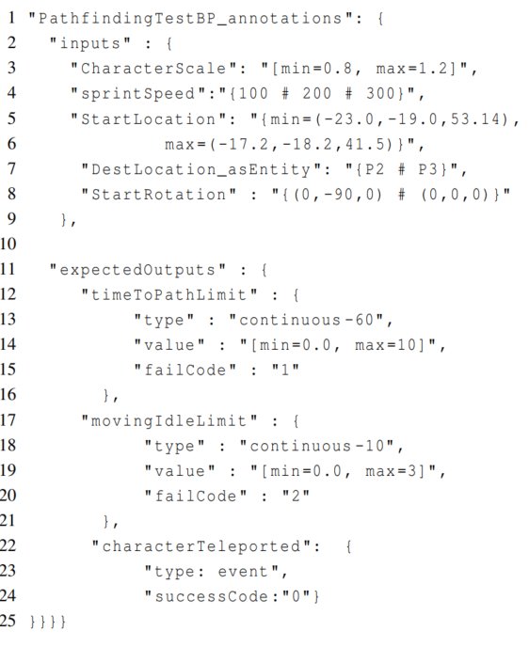


In our proposal, each blueprint or functionality has a Schema definition. This plays the role of an “annotation”, an optional guidance given by the user for the Fuzzer.
Optional Input guidance for Fuzzer
(a pathfinding blueprint example)
Ranges of values as interval between min-max
References to objects, e.g., P2, P3 spawn points in the map. Wildcards also supported !
Values sampled from a concrete set (3D vectors in this example)
When given, the test will be accepted if conditions are met.
Two continuous conditions:
a) need to find the path to a location in max 10 seconds,
b) Needs to move a bit at least every 3 seconds (otherwise stuck)
Note: each has a failure code and tested at every N frames
An event-based condition. If this event comes up, we return immediately as success.

Slide 13
In our proposal, each blueprint or functionality has a Schema definition. This plays the role of an “annotation”, an optional guidance given by the user for the Fuzzer.
(a pathfinding blueprint example)
Important feature: We support a full range persistent testing
Each blueprint or functionality has a Schema definition
Custom data types can be defined by users too !
For string types only, a set of compatible regex patterns.
E.g., an acceptance criterion for email addresses or usernames.
Check our paper for a formal abstractization of tests and blueprints !

Slide 14
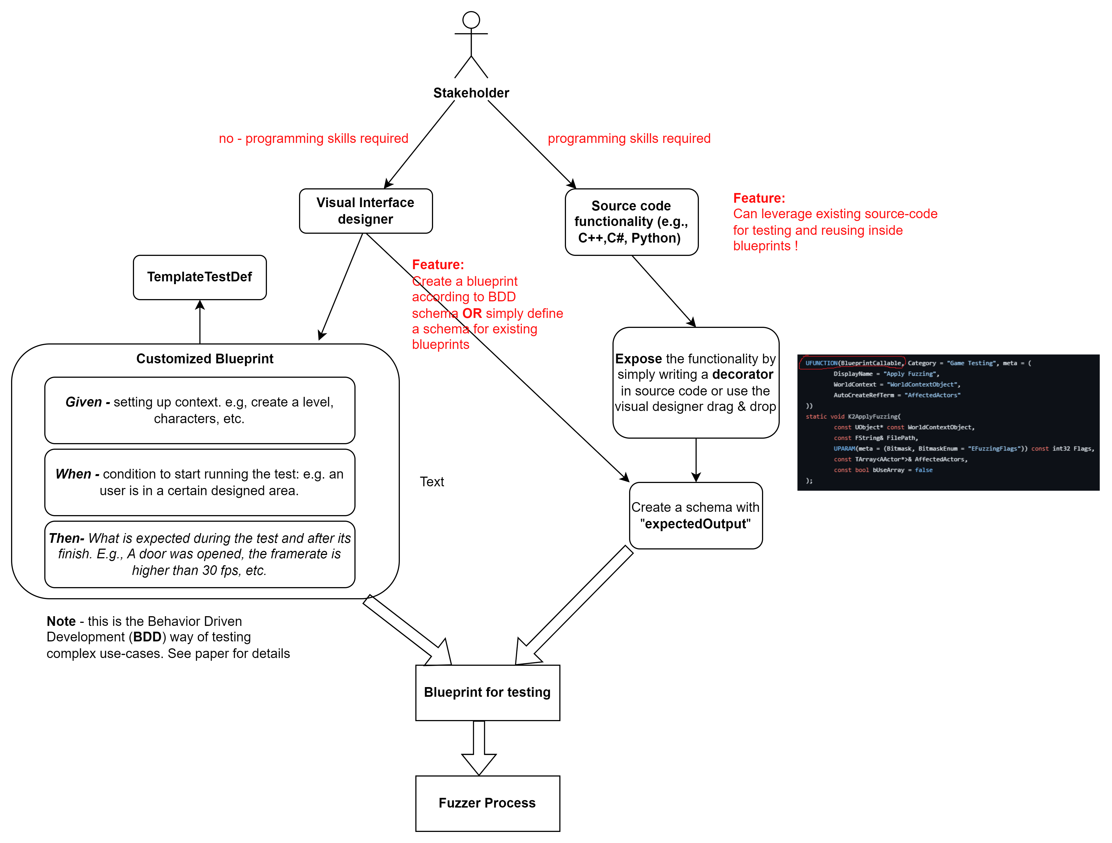
How to define tests ?

Slide 15
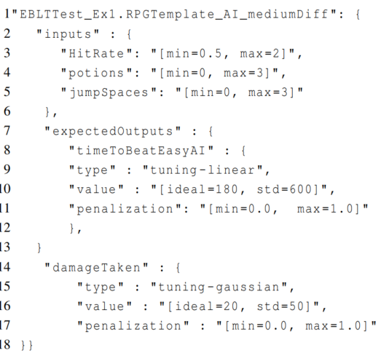
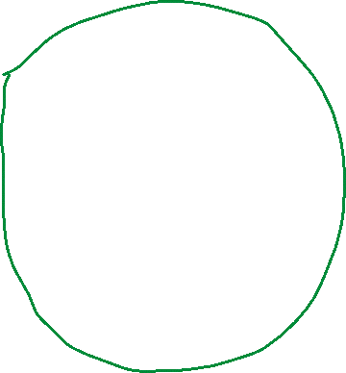

Using the framework for automated tuning
Define a schema with
- inputs ranges, sets, that you think of are reasonable
- expected outputs to define pass criteria
Passed inputs found
Fuzzer will sample from this defined space of values
(hitRate = 0.23, potions = 1.3, jumpSpaces = 1.31)
Fuzzer
(hitRate = 0.21, potions = 0.3, jumpSpaces = 2.31)
Pass criteria contains the mean and deviation of the output values
As well as a scoring function, e.g., Linear or Gaussian penalization
Check the paper for full details !
(hitRate = 0.15, potions = 1.0, jumpSpaces = 1.4)

Slide 16
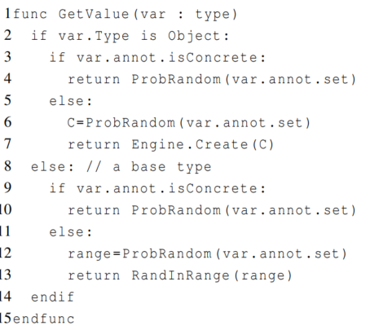
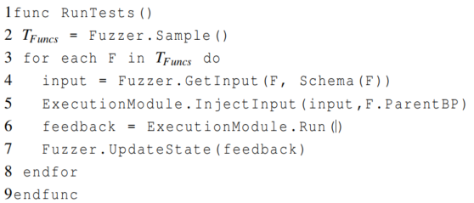
The blueprint fuzzing process pseudo code.
Pseudocode: Sampling values according to schema
Known in literature as: “whitebox fuzzing” !
For each input value in the schema call this.
Line 2
Line 4
Note: the testing agent can be anything, plugin-able architecture. E.g.:
- reinforcement learning based agents
- scripted agents that do dummy operations
- visual inputs only agents, e.g. check DeepMinds paper on ATARI games.
Line 6
Line 7

Slide 17
Prioritization of selected functionality to test
Consider a set of testable functions and their priority (and possibly a random function wildcard).
Then, stakeholders can manually prioritize work to test next
By default, framework automatically assigns probabilities based on the change rate and last modified time for each function.
Technically, the automated set of changes made is observed by:
Having a process that watches for new modified content, blueprints, and then generate tests based on those.
Having a process that evaluates the new classes and code pieces that have been added to the game and aligns the fuzzing processes around those more.
Line 2

Slide 18
4. Evaluation
A. Demo shows our functionalities tested in Unreal Engine public sample projects
An official training environment: Hour of Code,
An official city traffic simulator: City Sample
An RPG game template from marketplace
B. Industry evaluation: not released yet game product, 9 months.
Team: 4 software engineers (SEs), 3 game designers, 7 animators, 5 technical artis, 2 producers.
SEs developed new features to connect different parts of the engine or game logic, stress/load testing.
Other stakeholders: functional tests, or tests to evaluate quality on areas such as animations, rendering, or generated game balance/exploits.
https://www.unrealengine.com/marketplace/en-US/product/unreal-engine-hour-of-code
https://www.unrealengine.com/marketplace/en-US/product/city-sample
https://www.unrealengine.com/marketplace/en-US/product/top-down-rpg-template

Slide 19
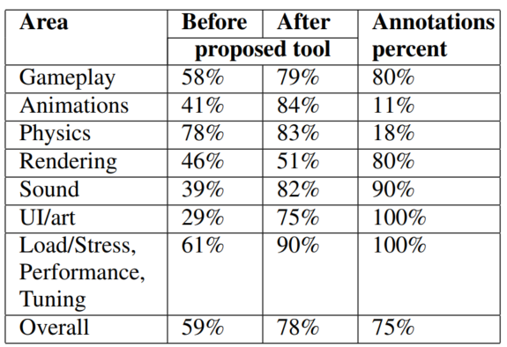
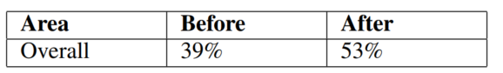
RQ1: Does the testing tool help increase the percentage of testable content in a project?
RQ2: Does the proposed testing tool help a project achieve higher code coverage (branch coverage)?
RQ3: What is the subjective opinion of the people
involved in the experiment (user study)?
We asked each for feedback about the - /low-code paradigm in general and how our tool can help in testing a project that uses it.
Conclusions:
A visual representation of the architecture and logic can greatly facilitate the testing process.
The input/output variables and the connections between components become more visible
The proposed annotation and BDD support can help to test, identify problems faster, and facilitate the maintenance of the project between cycles.

Slide 20
Demo time !
CompleteVideoDemo.mp4

Slide 21
5. Future work
Integrate the symbolic/concolic testing methods.
Current ideas: freeze states and discretize time steps when invoking the symbolic solver.
Improve the prioritization tool for areas of the games that need to be tested, or perhaps based on previous history of bugs that continue to occur.
Integration of previously published work on genetic algorithms and reinforcement learning to guide the fuzzing process.

Slide 22
Thank you! Q&A

Slide 23
Appendix / additional slides

Slide 24
Each blueprint or functionality has a Schema definition.
This plays the role of an “annotation”, an optional guidance given by the user for the Fuzzer.
Custom data types can be defined by users too !
For string types only, a set of compatible regex patterns. E.g., an acceptance criterion for email addresses or usernames.
For generic Object types (a concrete set of objects in the environment or wildcard types)

